Slide 1
Laptop Price prediction Using machine learning

Slide 2

Objective
SmartTech Co. has partnered with data science team to develop a robust machine learning model that predicts laptop prices accurately.
Client Requirement
Predict Laptop price based on its features
Analysing how well features are impacting its price
Providing insights on brand Perception and market demand

Slide 3
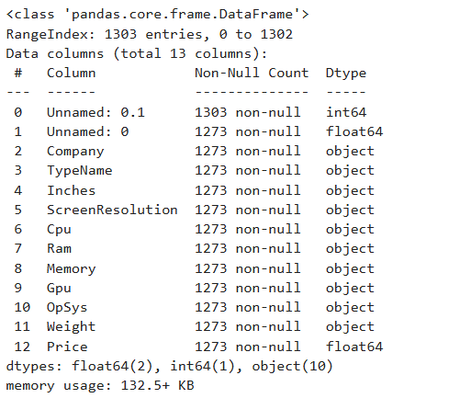
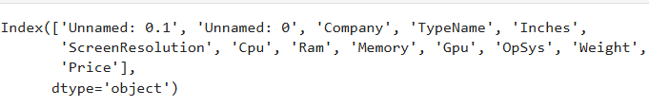
Project phase
Data Exploration and understanding
13 columns and 1303 rows
Exploring all the data types
Data Preprocessing
Dealing with Null values and outliers
Remove and rename all unneccasary features
Changing all the data types to appropriate type for furthure analysis
Dropping duplicates

Slide 4
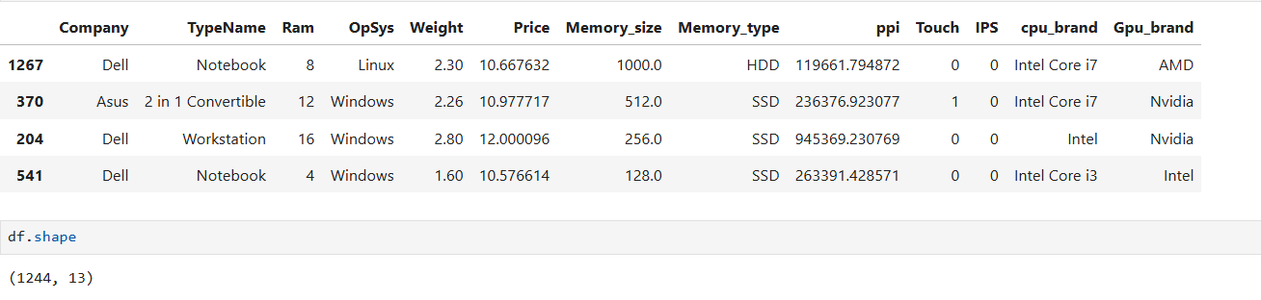
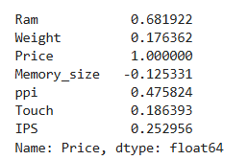
Feature Engineering
Extracting all the feature with required insights to improve performance of the model
Adding new columns ( ips, touchscreen and IPs)

Slide 5
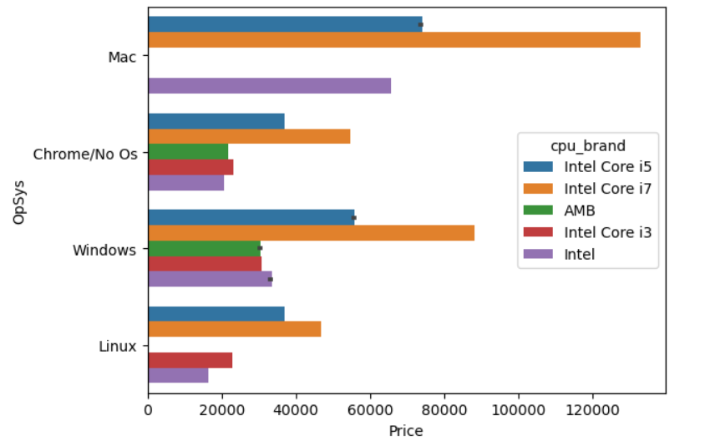
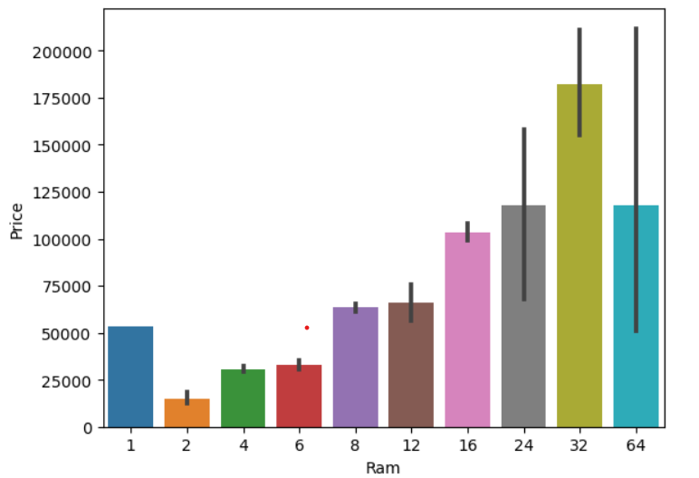
Data Visualization

Slide 6
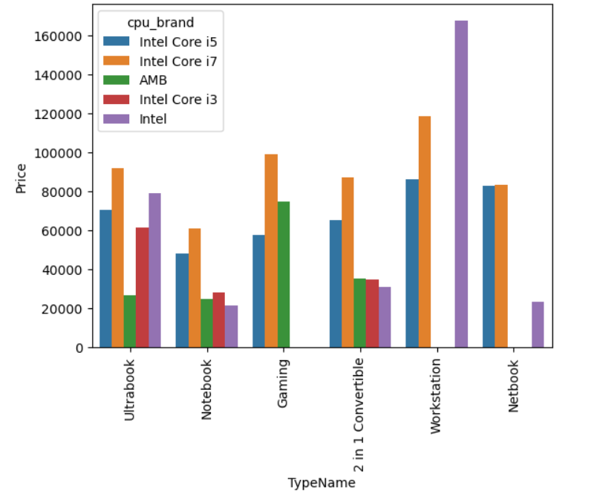
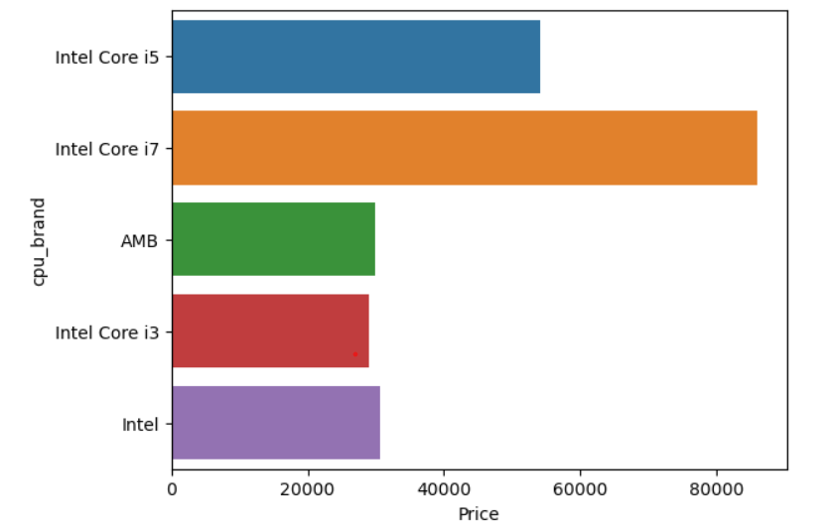

Slide 7
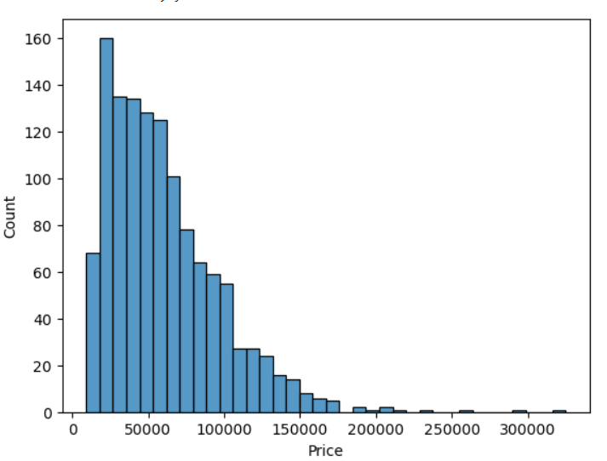
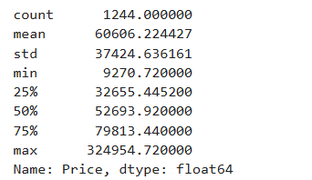
Price is right skewed around 1.51

Slide 8
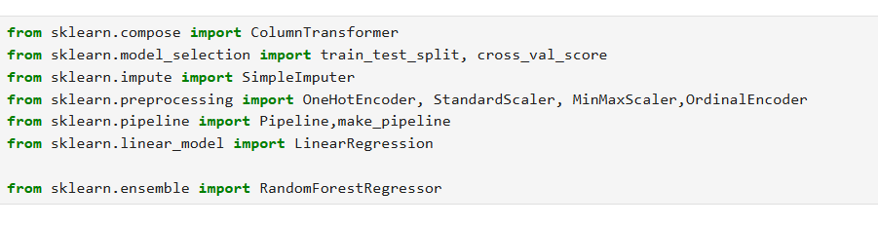
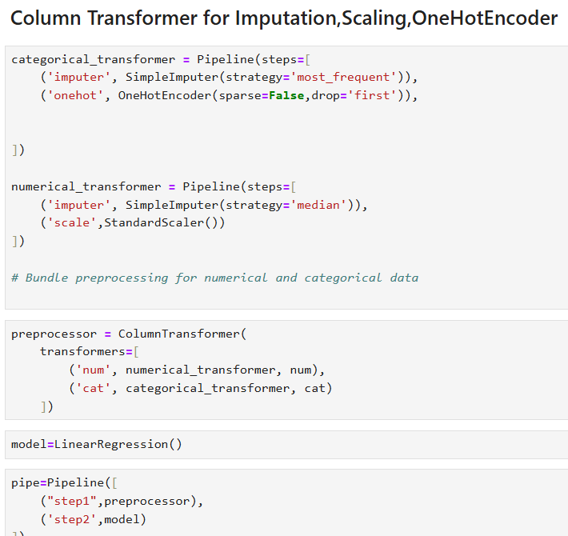
Model Training libraries imported
Feature scaling and Encoding with column Transformer

Slide 9
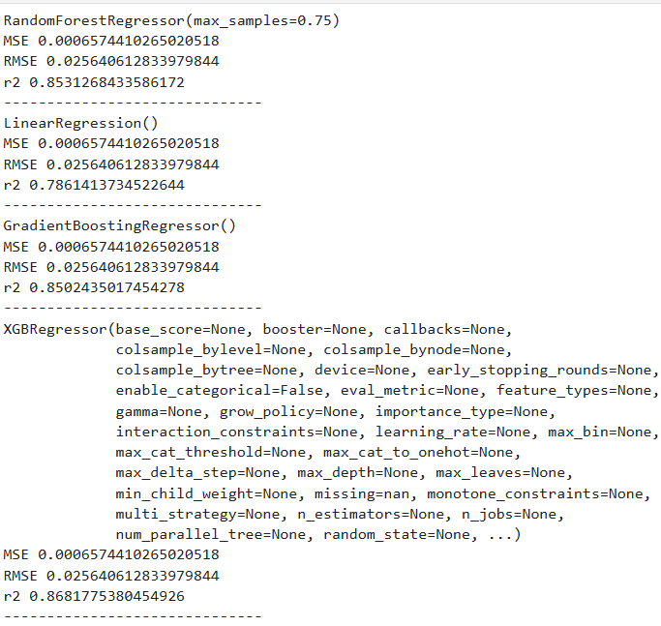
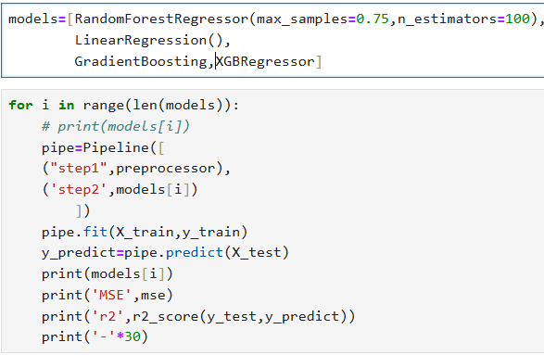
Model evaluation evaluating the performance of the models with all metrics

Slide 10
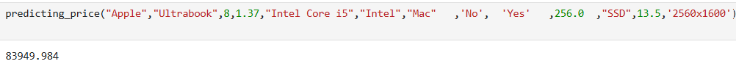
Real Time prediction
Using hyper parameter tuning in xgboost r2 increase to 0.87

Slide 11
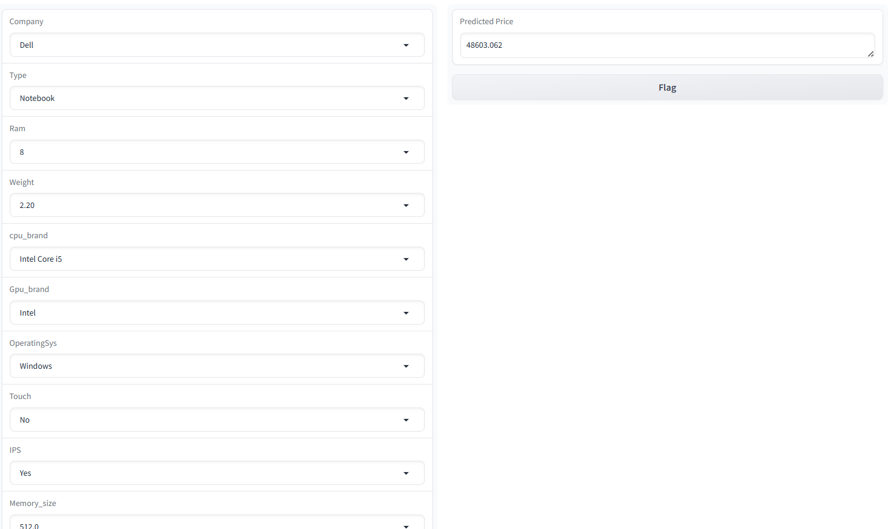
Deployement of model on user-interface using gradio
summary
Model able to predict accurately around 88% with new laptops
Operating sys and processor influence more on price
Features like ram, processor, Ips, touch can vary in price
Change in new technology and updates on feature can vary on price
prediction

